Slide 1
Name:Suhail Abdul Khader Roll no.17225760070
End Sem Report

Slide 2

PUBG Finish Placement Prediction
Can you predict the battle royale finish of PUBG Players?

Slide 3
Problem Statement
In a PUBG game, up to 100 players start in each match (matchId). Players can be on teams (groupId) which get ranked at the end of the game (winPlacePerc) based on how many other teams are still alive when they are eliminated. In game, players can pick up different munitions, revive downed-but-not-out (knocked) teammates, drive vehicles, swim, run, shoot, and experience all of the consequences -- such as falling too far or running themselves over and eliminating themselves.
You are provided with a large number of anonymized PUBG game stats, formatted so that each row contains one player's post-game stats. The data comes from matches of all types: solos, duos, squads, and custom; there is no guarantee of there being 100 players per match, nor at most 4 player per group.
You must create a model which predicts players' finishing placement based on their final stats, on a scale from 1 (first place) to 0 (last place).

Slide 4
Business Understanding
Capturing ,retaintion of customers(gamers)
87 million daily active users
50million units sold online for PC where as around 400 million unit for free mobile version
Improving InApp purchasing for potential customers

Slide 5
Approach
Gathering Data : Obtained Data from Kaggle(https://www.kaggle.com/c/pubg-finish-placement-prediction/data)
Data Preparation:
Memory Reduction because this Dataset is very large
Training set: Memory usage of dataframe is 983.90 MB, Memory usage after optimization is: 288.39 MB Decreased by 70.7%
Testing Set: Memory usage of dataframe is 413.18 MB Memory usage after optimization is: 121.74 MB Decreased by 70.5%
Choosing model:
Single column, binary values (classification problem, one sample belongs to one class only and there are only two classes)
Single column, real values (regression problem, prediction of only one value)
Multiple column, binary values (classification problem, one sample belongs to one class, but there are more than two classes)
Multiple column, real values (regression problem, prediction of multiple values)
And multilabel (classification problem, one sample can belong to several classes)
Training :
Evaluation :
Parameter Tuning :

Slide 6
Data Understanding
Training set : (4357336, 26)
Testing set : (1867913, 25)
DBNOs - Number of enemy players knocked.
assists - Number of enemy players this player damaged that were killed by teammates.
boosts - Number of boost items used.
damageDealt - Total damage dealt. Note: Self inflicted damage is subtracted.
headshotKills - Number of enemy players killed with headshots.
heals - Number of healing items used.
Id - Player’s Id
killPlace - Ranking in match of number of enemy players killed.
killPoints - Kills-based external ranking of player. (Think of this as an Elo ranking where only kills matter.) If there is a value other than -1 in rankPoints, then any 0 in killPoints should be treated as a “None”.
killStreaks - Max number of enemy players killed in a short amount of time.
kills - Number of enemy players killed.
longestKill - Longest distance between player and player killed at time of death. This may be misleading, as downing a player and driving away may lead to a large longestKill stat.
matchDuration - Duration of match in seconds.
matchId - ID to identify match. There are no matches that are in both the training and testing set.

Slide 7
revives - Number of times this player revived teammates.
rideDistance - Total distance traveled in vehicles measured in meters.
roadKills - Number of kills while in a vehicle.
swimDistance - Total distance traveled by swimming measured in meters.
teamKills - Number of times this player killed a teammate.
vehicleDestroys - Number of vehicles destroyed.
walkDistance - Total distance traveled on foot measured in meters.
weaponsAcquired - Number of weapons picked up.
winPoints - Win-based external ranking of player. (Think of this as an Elo ranking where only winning matters.) If there is a value other than -1 in rankPoints, then any 0 in winPoints should be treated as a “None”.
groupId - ID to identify a group within a match. If the same group of players plays in different matches, they will have a different groupId each time.
numGroups - Number of groups we have data for in the match.
maxPlace - Worst placement we have data for in the match. This may not match with numGroups, as sometimes the data skips over placements.
winPlacePerc - The target of prediction. This is a percentile winning placement, where 1 corresponds to 1st place, and 0 corresponds to last place in the match. It is calculated off of maxPlace, not numGroups, so it is possible to have missing chunks in a match.
matchType - String identifying the game mode that the data comes from. The standard modes are “solo”, “duo”, “squad”, “solo-fpp”, “duo-fpp”, and “squad-fpp”; other modes are from events or custom matches.
rankPoints - Elo-like ranking of player. This ranking is inconsistent and is being deprecated in the API’s next version, so use with caution. Value of -1 takes place of “None”.

Slide 8
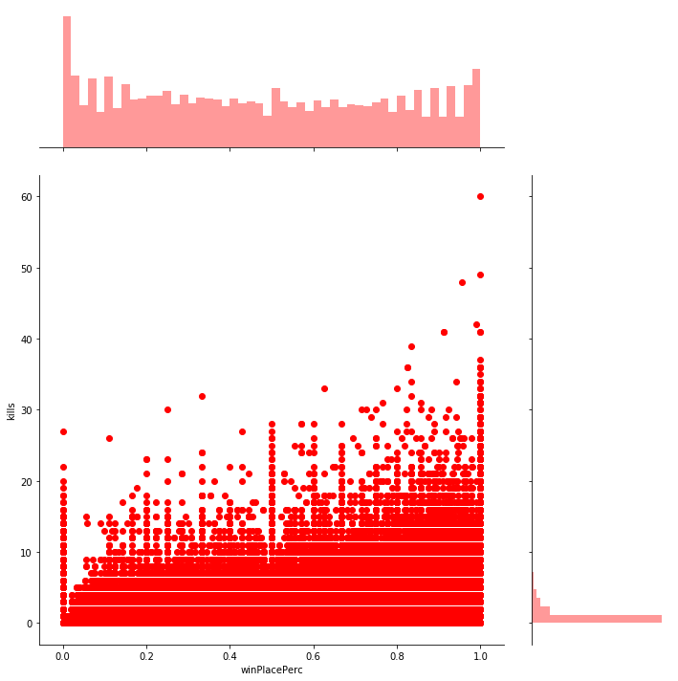
EDA & Visualization
Analyzing Kills and kills related Column:
Longest kill: 1323 meters
The average person kills 0.9345 players, 99% of people have 7.0 kills or less, while the most kills ever recorded is 60.
16722 players (0.3838%) have won without a single kill! 4262 players (0.0978%) have won without dealing damage.
Killing has a correlation with winning. i.e kills column with win

Slide 9
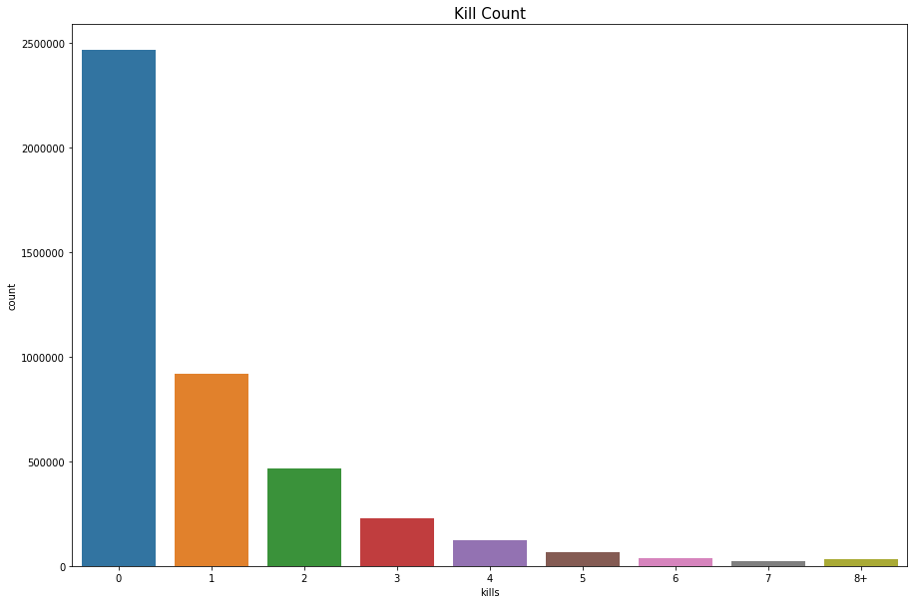

Slide 10
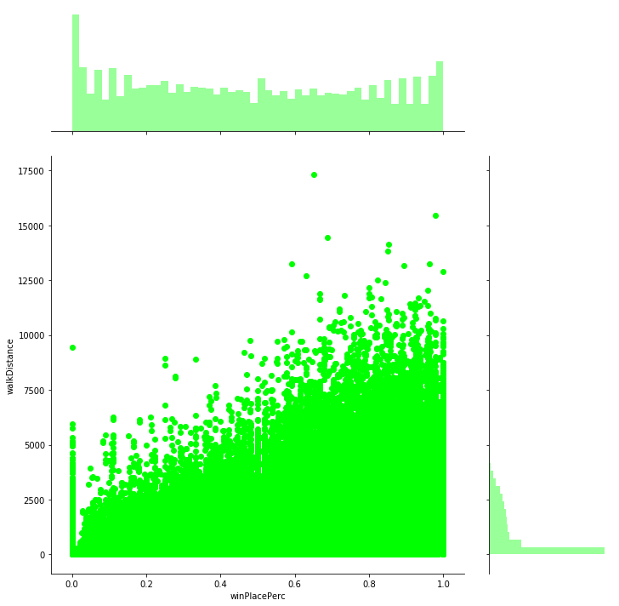
Analyzing walkDistance column:
The average person walks for 1055.1m, 99% of people have walked 4138.0m or less, while the highest walked distance is for 17300.0m.
94306 players (2.0581%) walked 0 meters. This means that they die before even taking a step or they are afk (more possible).
Walking has a high correlation with winPlacePerc.

Slide 11
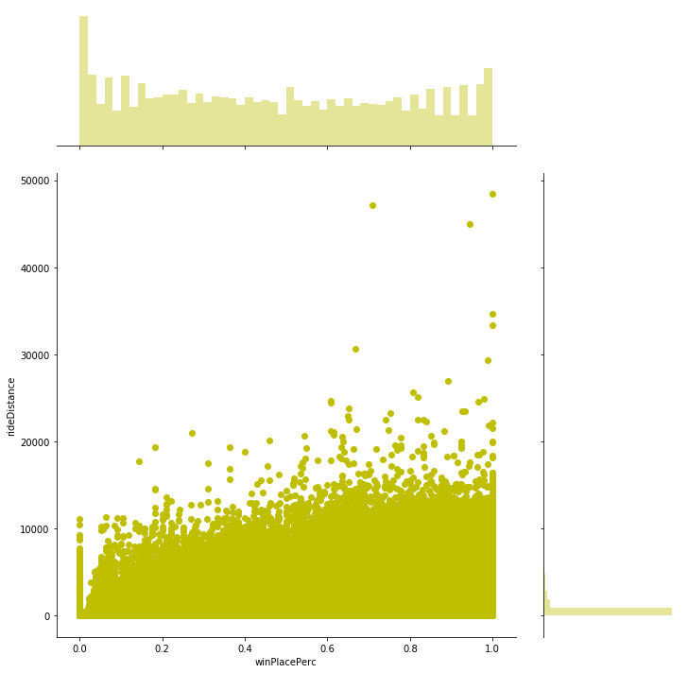
Analyzing rideDistance Column
The average person drives for 423.9m, 99% of people have drived 6133.0m or less, while the formula 1 champion drived for 48390.0m.
3439985 players (22.7940%) drived for 0 meters.
There is a small correlation between rideDistance and winPlacePerc
sns.jointplot(x="winPlacePerc", y="rideDistance", data=train, height=10, ratio=3, color="y") plt.show()

Slide 12
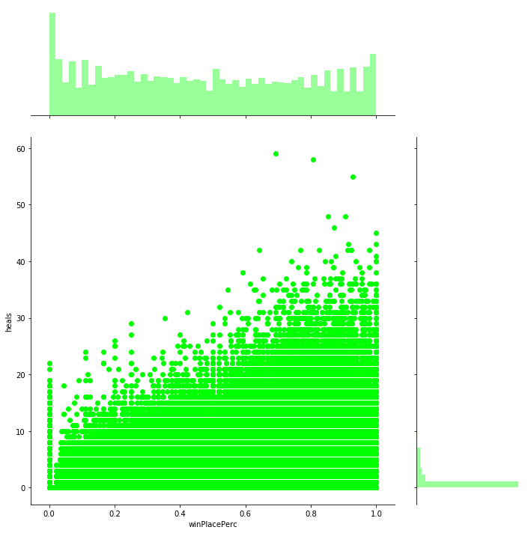
To Analyze heals, Boosts column
The average person uses 1.2 heal items, 99% of people use 11.0 or less, while the doctor used 59.
The average person uses 1.0 boost items, 99% of people use 7.0 or less, while the doctor used 18.
healing and boosting, definitely are correlated with winPlacePerc. Boosting is more.

Slide 13
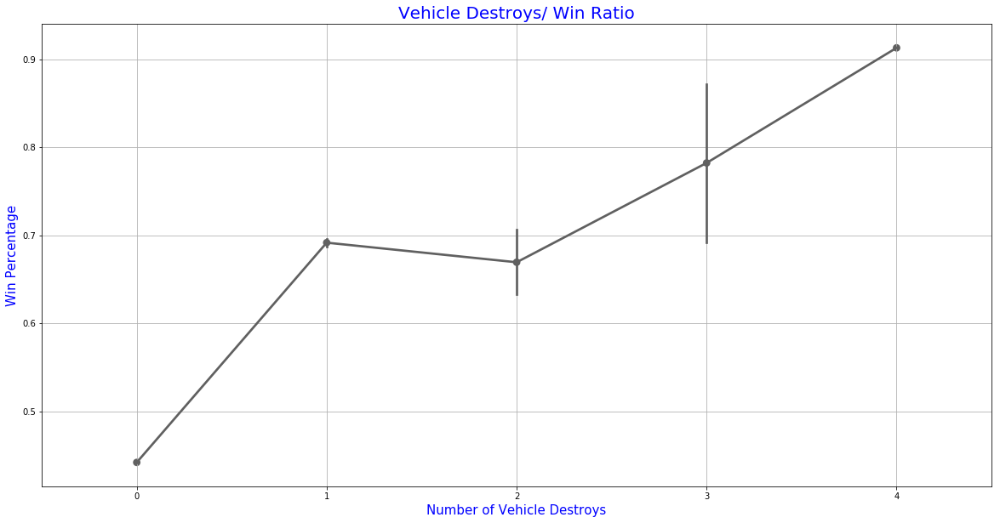
Analyzing vehicleDestroys column
Destroying a single vehicle increases your chances of winning!
High correlation with Win percentage.

Slide 14
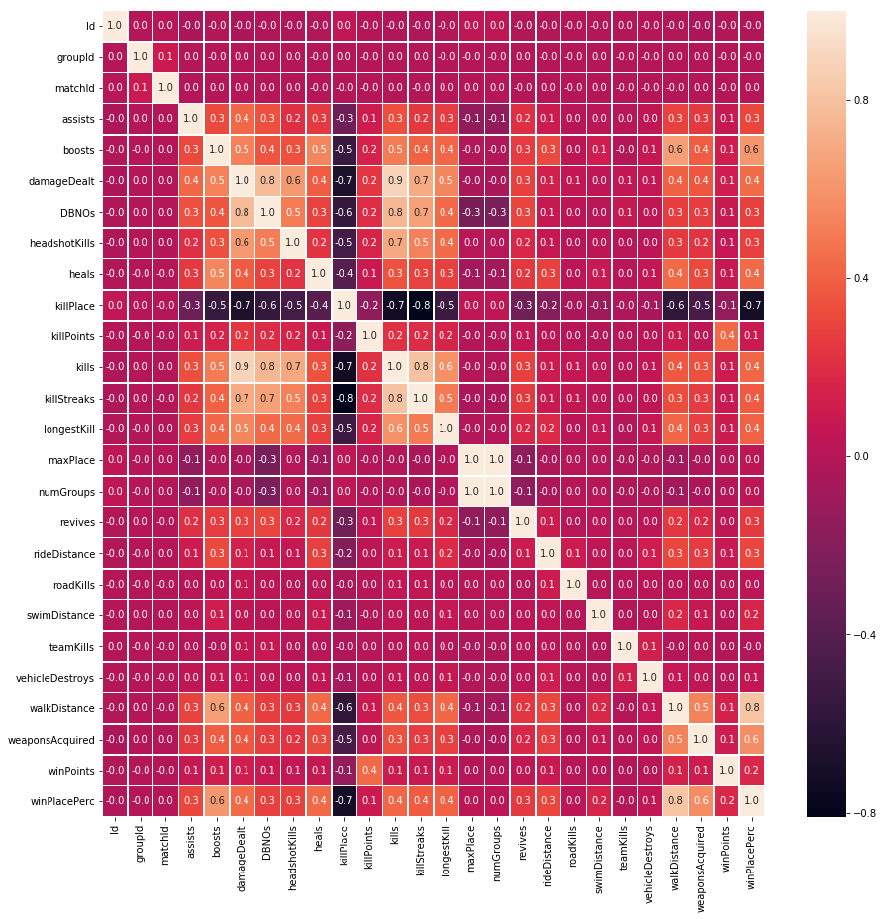
Pearson correlation between variables

Slide 15
Feature Engineering
Initially there were 29 features which was increased to 68 features after feature engineeering
Below are the few important features
PlayerJoined Column : here count the unique matchId
killsNorm
DamageDealtNorm : normalize kills and damagedealt
totalDistance : i.e.(walk+swim+ride)
healsNboosts
teamKillRank
totalItemsAcquired
Itemsperdistance
Killsperdistance
Total_team_items

Slide 16
Model Building
Here we use K-fold cross validation for Light GBM
Light GBM is gradient boosting framework which uses tree based learning algorithm
Light GBM grows tree vertically while other algorithm grows trees horizontally meaning that Light GBM grows tree leaf-wise while other algorithm grows level-wise. It will choose the leaf with max delta loss to grow. When growing the same leaf, Leaf-wise algorithm can reduce more loss than a level-wise algorithm.
Why Light GBM
Extremely Fast
Handles large datasets
Takes low memory to run
Focuses on Accuracy
Supports GPU Learning
Installing Light GBM
conda install -c conda-forge lightgbm

Slide 17
Parameters of Light GBM
Control Parameters
Max_depth (helps In reducing overfitting)
Min_Data_in_leaf(similar to minbucket)
Min_gain_to_split(similar to minsplit)
Lambda : specifies regularization. Typical value ranges from 0 to 1.
Metric Parameters
Metric : mae(mean absolute error)
Mse(mean squared error)
Binary_logloss(loss for binary classification)
Multi_logloss(loss for multi classification)
learning_rate: This determines the impact of each tree on the final outcome. GBM works by starting with an initial estimate which is updated using the output of each tree. The learning parameter controls the magnitude of this change in the estimates. Typical values: 0.1, 0.001, 0.003…

Slide 18
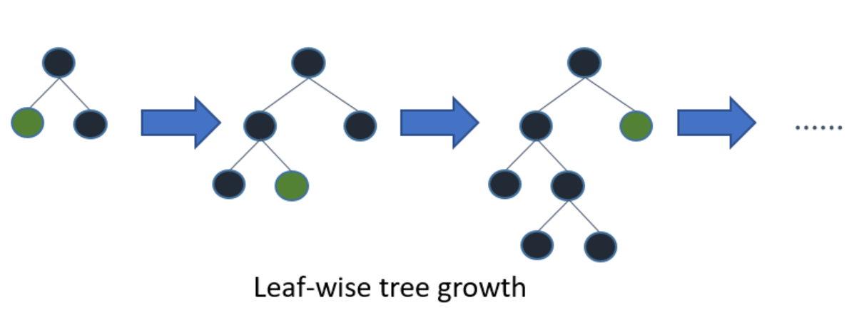
How Light GBM works

Slide 19
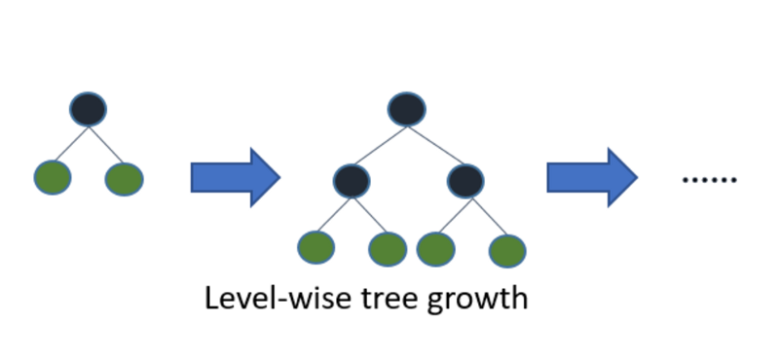
How other boosting techniques work

Slide 20
Here is how k-fold cross validation works
Split the dataset into k equal parts(folds)
Use 1 fold for testing and other k-1 fold for training
Calculate test accuracy
Repeat above steps
Use avg of test accuracy as the estimate for sample
Advantages of cross-validation
More accurate estimate out of sample accuracy
Most efficient use of data

Slide 21
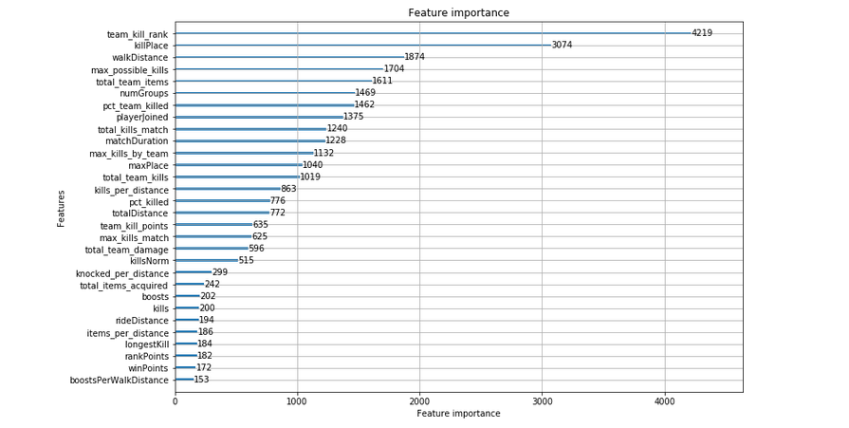
Feature importance using Light LGB

